Slide 1

Topic 3: Anticompetitive strategies
Industrial Organisation / Matěj Bajgar

Slide 2

What do you remember from last week‘s lecture?

Slide 3

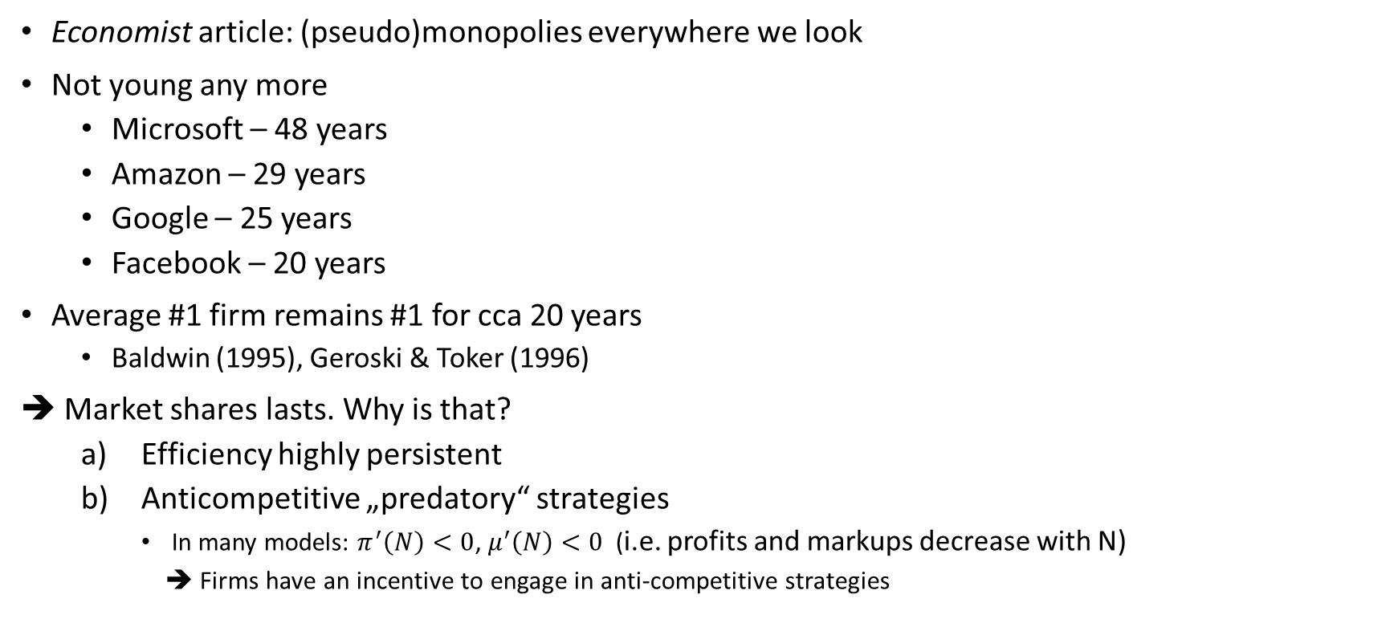
Anti-competitive strategies
Economist article: (pseudo)monopolies everywhere we look
Not young any more
Microsoft – 48 years
Amazon – 29 years
Google – 25 years
Facebook – 20 years
Average #1 firm remains #1 for cca 20 years
Baldwin (1995), Geroski & Toker (1996)
➔ Market shares lasts. Why is that?
Efficiency highly persistent
Anticompetitive „predatory“ strategies
In many models: $π^{′}\left(N\right)<0$, $μ^{′}\left(N\right)<0$ (i.e. profits and markups decrease with N)
➔ Firms have an incentive to engage in anti-competitive strategies

Slide 4
Topic outline
Basic model of entry deterrence
Taxonomy of strategies
Capacity investment as a committment device
What is “brand proliferation”?
Is there such a thing as predatory pricing?
Can firms leverage market power across markets?
What makes exclusionary contracts profitable?

Slide 5


What’s in it for me?

Slide 6
Topic outline
Basic model of entry deterrence
Taxonomy of strategies
Capacity investment as a committment device
What is “brand proliferation”?
Is there such a thing as predatory pricing?
Can firms leverage market power across markets?
What makes exclusionary contracts profitable?

Slide 7
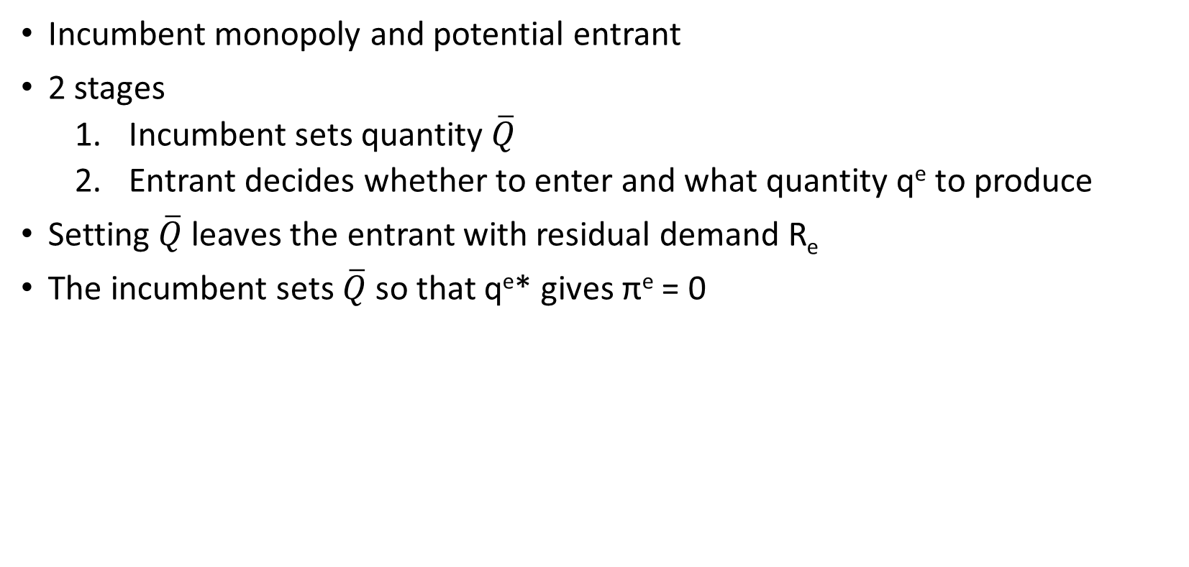
Basic model of entry deterrence
Incumbent monopoly and potential entrant
2 stages
Incumbent sets quantity $\overline{Q}$
Entrant decides whether to enter and what quantity q^{e} to produce
Setting $\overline{Q}$ leaves the entrant with residual demand R_{e}
The incumbent sets $\overline{Q}$so that q^{e}* gives π^{e} = 0

Slide 8
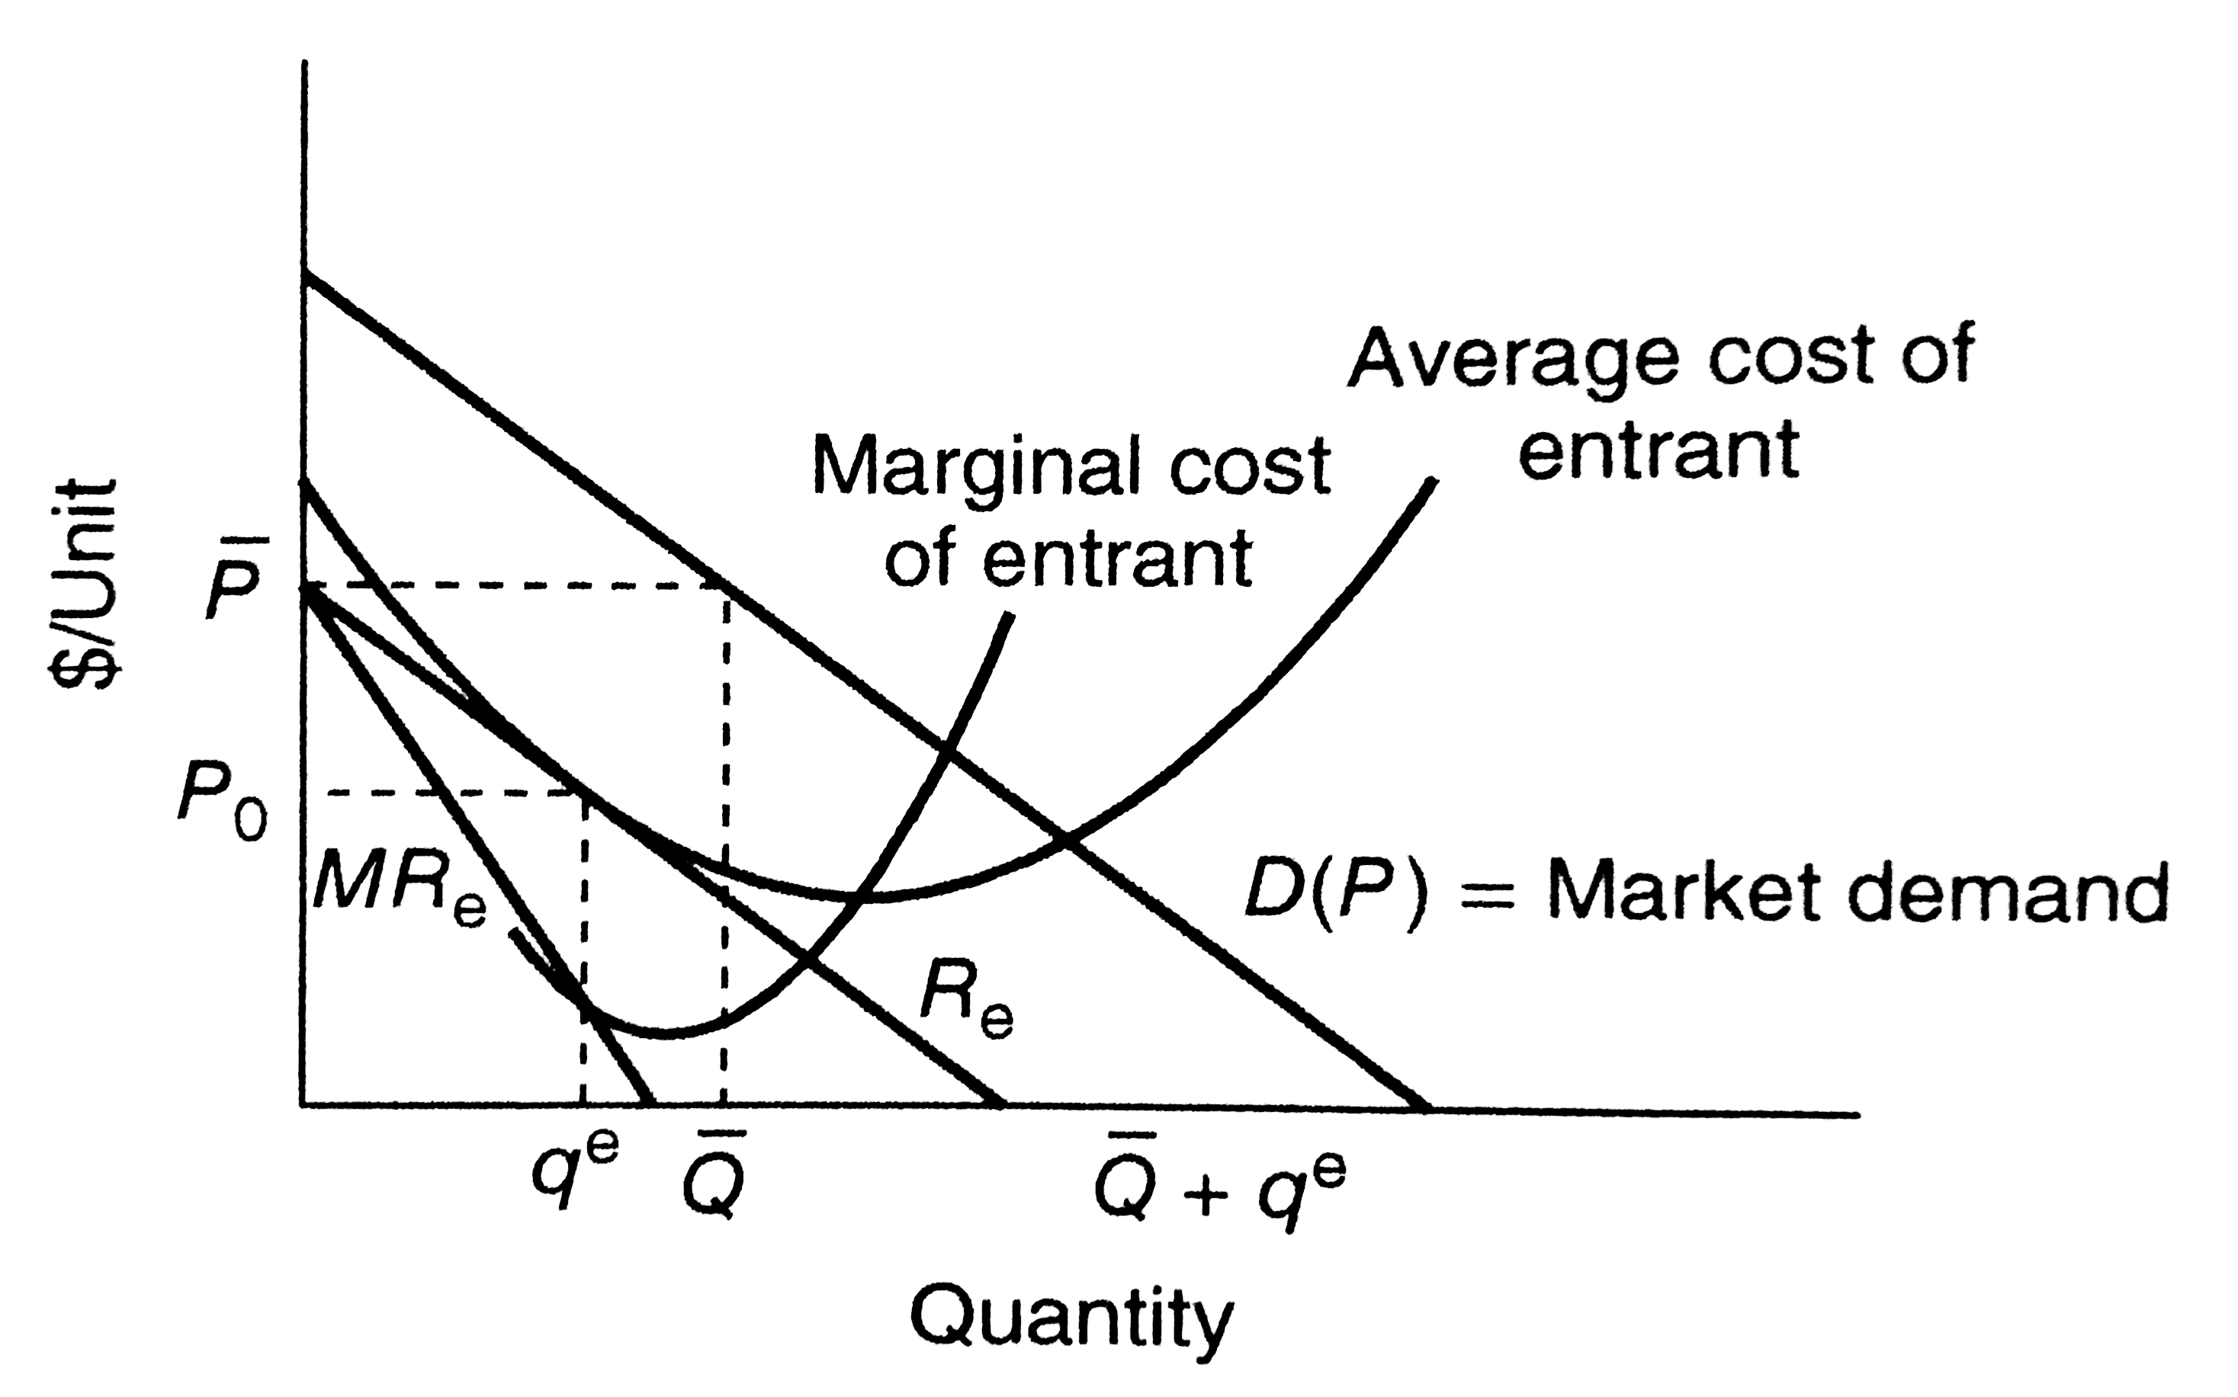
Basic model of entry deterrence
The incumbent selects $\overline{Q}$ so that the residual demand curve R_{e} touches the average cost curve of the entrant
Notes:
Q_bar set so that the maginal

Slide 9

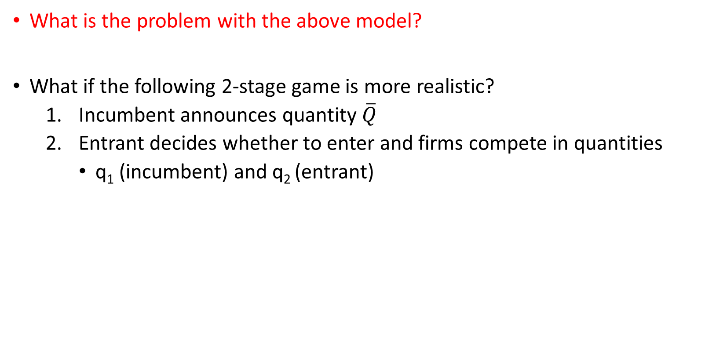
Basic model of entry deterrence
What is the problem with the above model?
What if the following 2-stage game is more realistic?
Incumbent announces quantity $\overline{Q}$
Entrant decides whether to enter and firms compete in quantities
q₁ (incumbent) and q₂ (entrant)

Slide 10
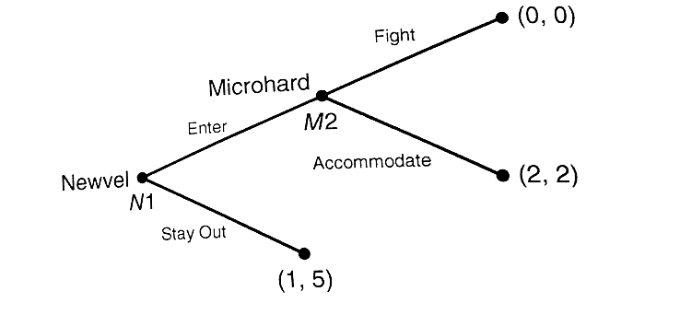
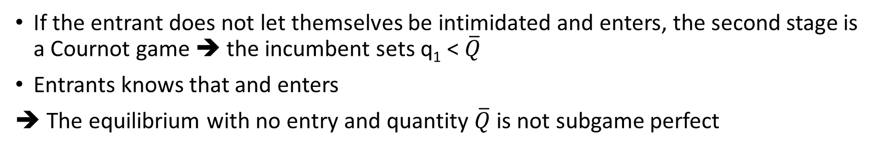
Basic model of entry deterrence
If the entrant does not let themselves be intimidated and enters, the second stage is a Cournot game ➔ the incumbent sets q₁ < $\overline{Q}$
Entrants knows that and enters
➔ The equilibrium with no entry and quantity $\overline{Q}$is not subgame perfect

Slide 11
Role of commitment
A threat of deterrence not credible if the incumbent is motivated to not follow through in the 2nd round
The incumbent has to commit through some irreversible (or costly-to-reverse) actions
E.g. capacity investment

Slide 12
Topic outline
Basic model of entry deterrence
Taxonomy of strategies
Capacity investment as a committment device
What is “brand proliferation”?
Is there such a thing as predatory pricing?
Can firms leverage market power across markets?
What makes exclusionary contracts profitable?

Slide 13
Some definitions
Predatory conduct = conduct profitable only if preventing entry or leading to exit of rivals
i.e. seemingly irrational
Entry deterrence = aims to make entry unprofitable
Entry accommodation = aims make entry less harmful to profits
Entry blockaded = entry unprofitable even without deterrence
because of natural (or innocent) entry barriers
Limit pricing = setting low price to deter entry

Slide 14
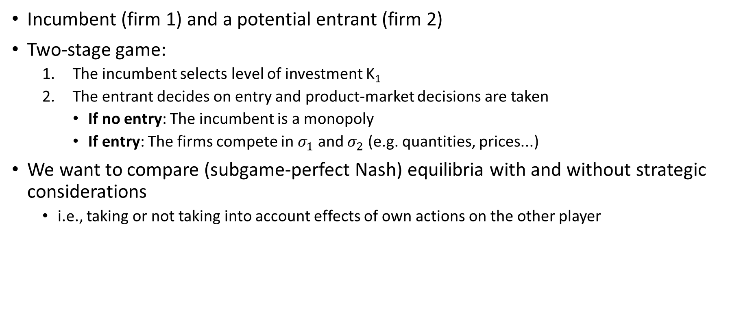
Taxonomy of strategies: setup
Incumbent (firm 1) and a potential entrant (firm 2)
Two-stage game:
The incumbent selects level of investment K₁
The entrant decides on entry and product-market decisions are taken
If no entry: The incumbent is a monopoly
If entry: The firms compete in $σ_{1}$ and $σ_{2}$ (e.g. quantities, prices...)
We want to compare (subgame-perfect Nash) equilibria with and without strategic considerations
i.e., taking or not taking into account effects of own actions on the other player

Slide 15
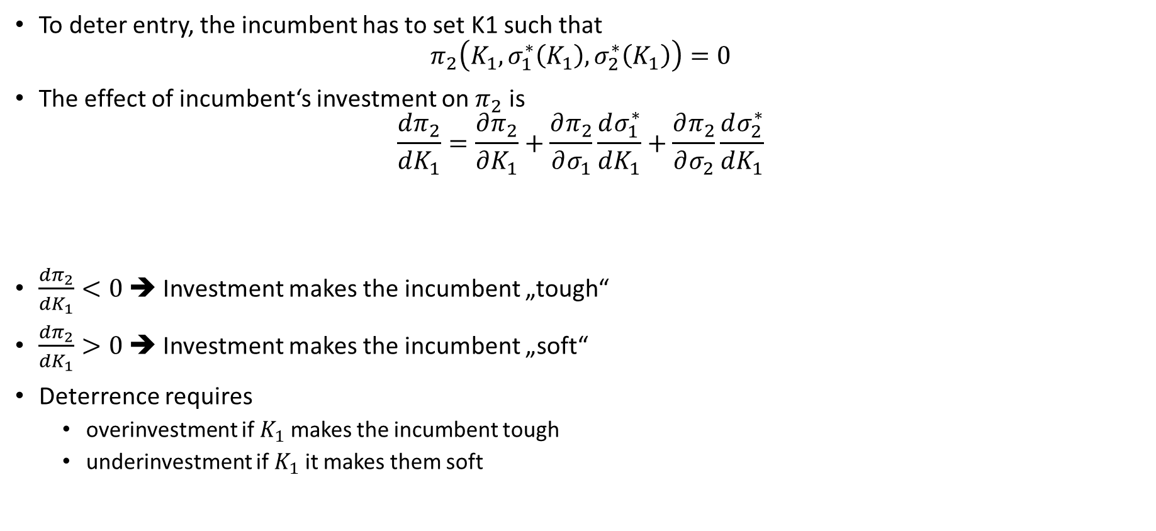
Taxonomy of strategies: entry deterrence
To deter entry, the incumbent has to set K1 such that
$$π_{2}\left(K_{1},σ_{1}^{∗}\left(K_{1}\right),σ_{2}^{∗}\left(K_{1}\right)\right)=0$$
The effect of incumbent‘s investment on $π_{2}$ is
$$\frac{dπ_{2}}{dK_{1}}=\frac{∂π_{2}}{∂K_{1}}+\frac{∂π_{2}}{∂σ_{1}}\frac{dσ_{1}^{∗}}{dK_{1}}+\frac{∂π_{2}}{∂σ_{2}}\frac{dσ_{2}^{∗}}{dK_{1}}$$
$\frac{dπ_{2}}{dK_{1}}<0$ ➔ Investment makes the incumbent „tough“
$\frac{dπ_{2}}{dK_{1}}>0$ ➔ Investment makes the incumbent „soft“
Deterrence requires
overinvestment if $K_{1}$ makes the incumbent tough
underinvestment if $K_{1}$ it makes them soft
Direct effect
Strategic effect on deterrence (SED)
0 (envelope theorem)

Slide 16

Taxonomy of strategies: entry deterrence
Direct or indirect effect? What is the effect on the incumbent?
Capacity investment
Negative advertising about the entrant
R&D investment
Advertising to promote a brand
Acquiring a key supplier
Introducing new products
Lobbying for tougher regulation
Advertising to popularise a type of product

Slide 17
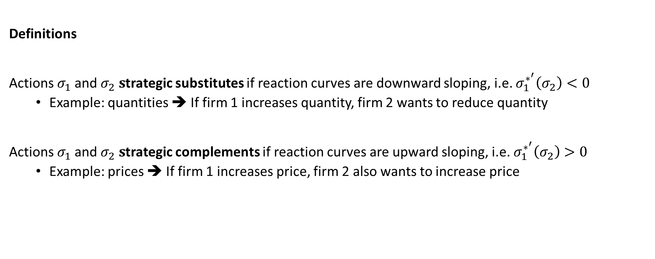
Strategic substitutes and complements
Definitions
Actions $σ_{1}$and $σ_{2} s$trategic substitutes if reaction curves are downward sloping, i.e. $σ_{1}^{∗^{′}}\left(σ_{2}\right)<0$
Example: quantities ➔ If firm 1 increases quantity, firm 2 wants to reduce quantity
Actions $σ_{1}$and $σ_{2} s$trategic complements if reaction curves are upward sloping, i.e. $σ_{1}^{∗^{′}}\left(σ_{2}\right)>0$
Example: prices ➔ If firm 1 increases price, firm 2 also wants to increase price

Slide 18
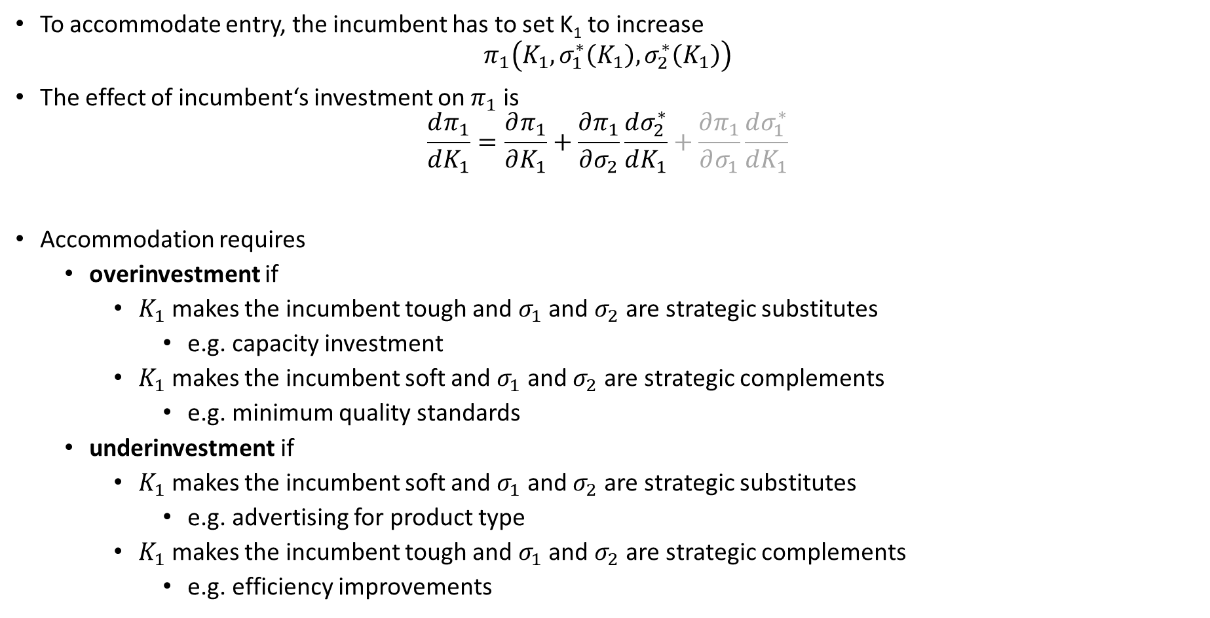
Taxonomy of strategies: entry accommodation
To accommodate entry, the incumbent has to set K₁ to increase
$$π_{1}\left(K_{1},σ_{1}^{∗}\left(K_{1}\right),σ_{2}^{∗}\left(K_{1}\right)\right)$$
The effect of incumbent‘s investment on $π_{1}$ is
$$\frac{dπ_{1}}{dK_{1}}=\frac{∂π_{1}}{∂K_{1}}+\frac{∂π_{1}}{∂σ_{2}}\frac{dσ_{2}^{∗}}{dK_{1}}+\frac{∂π_{1}}{∂σ_{1}}\frac{dσ_{1}^{∗}}{dK_{1}}$$
Accommodation requires
overinvestment if
$K_{1}$ makes the incumbent tough and $σ_{1}$ and $σ_{2}$ are strategic substitutes
e.g. capacity investment
$K_{1}$ makes the incumbent soft and $σ_{1}$ and $σ_{2}$ are strategic complements
e.g. minimum quality standards
underinvestment if
$K_{1}$ makes the incumbent soft and $σ_{1}$ and $σ_{2}$ are strategic substitutes
e.g. advertising for product type
$K_{1}$ makes the incumbent tough and $σ_{1}$ and $σ_{2}$ are strategic complements
e.g. efficiency improvements
Direct effect
Strategic effect on accommodation (SEE)
0 (envelope theorem)

Slide 19
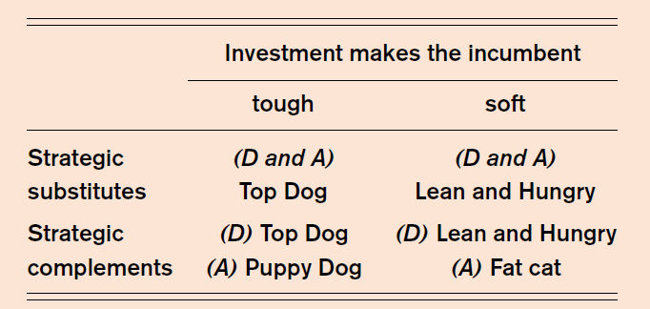
Taxonomy of strategies: summary

Slide 20
Exercise: Quantity committment
Two firms competing in quantities
Two periods
Period 1 – Firm 1 is a monopolist
Period 2 – Possible entry
In each period
inverse demand p = 20 – q₁ – q₂
fixed costs f=9 and marginal costs c=4
What would p, q₁ and profits be in each period if, for administrative reasons, no entry was possible?
Assume for technical reasons firm 1 has to choose the same quanity in both periods. Firm 2 observes q₁ in the first period and subsequently sets q₂(q₁). What will it be?
Assume firm 2 does enter in period 2. What q₁ will firm 1 set (for both periods)? Determine equilibrium prices, quantities, profits?
But firm 2 only enters if it makes positive profits. What will be the subgame-perfect equilibrium of the 2-period model?

Slide 21
Topic outline
Basic model of entry deterrence
Taxonomy of strategies
Capacity investment as a committment device
What is “brand proliferation”?
Is there such a thing as predatory pricing?
Can firms leverage market power across markets?
What makes exclusionary contracts profitable?

Slide 22
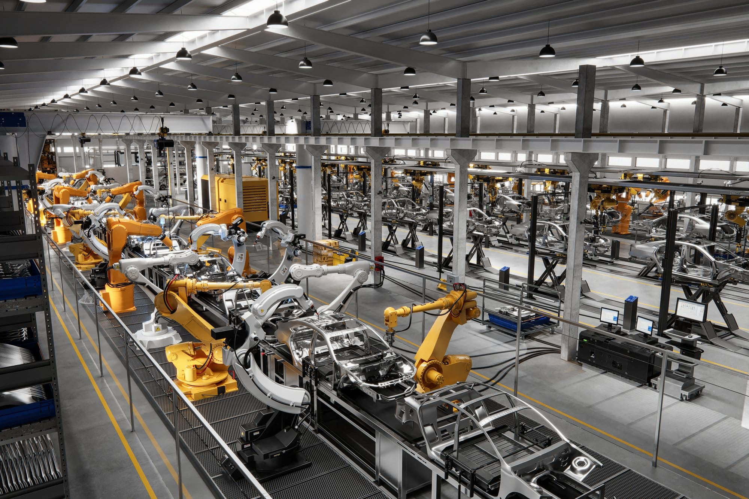
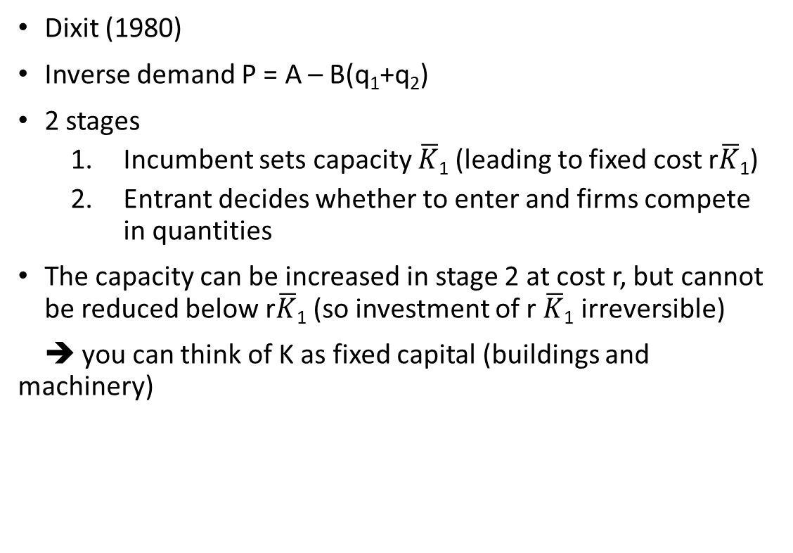
Capacity expansion as a commitment mechanism
Dixit (1980)
Inverse demand P = A – B(q₁+q₂)
2 stages
Incumbent sets capacity $\overline{K}$₁ (leading to fixed cost r$\overline{K}$₁)
Entrant decides whether to enter and firms compete in quantities
The capacity can be increased in stage 2 at cost r, but cannot be reduced below r$\overline{K}$₁ (so investment of r $\overline{K}$₁ irreversible)
➔ you can think of K as fixed capital (buildings and machinery)

Slide 23
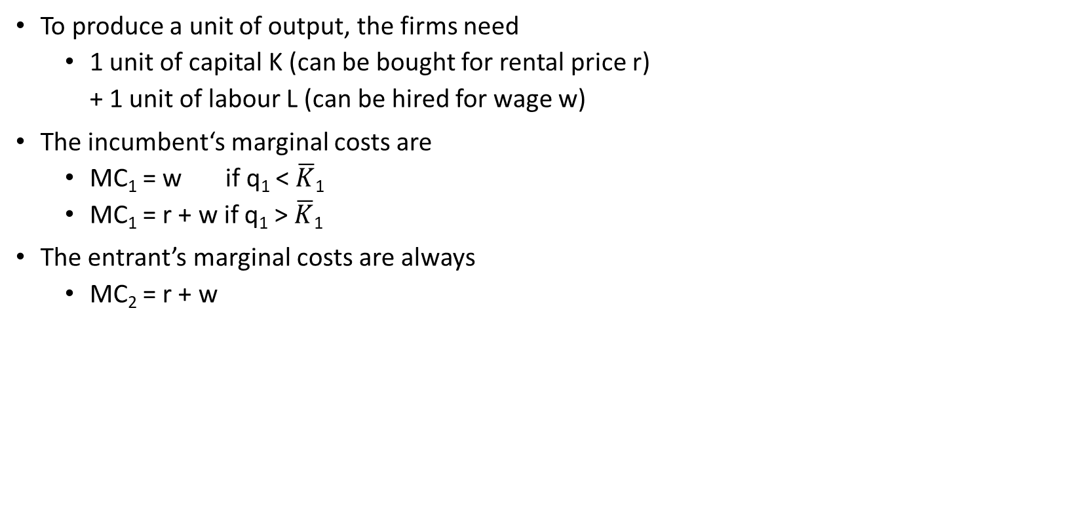
Capacity expansion as a commitment mechanism
To produce a unit of output, the firms need
1 unit of capital K (can be bought for rental price r)
+ 1 unit of labour L (can be hired for wage w)
The incumbent‘s marginal costs are
MC₁ = w if q₁ < $\overline{K}$₁
MC₁ = r + w if q₁ > $\overline{K}$₁
The entrant’s marginal costs are always
MC₂ = r + w

Slide 24
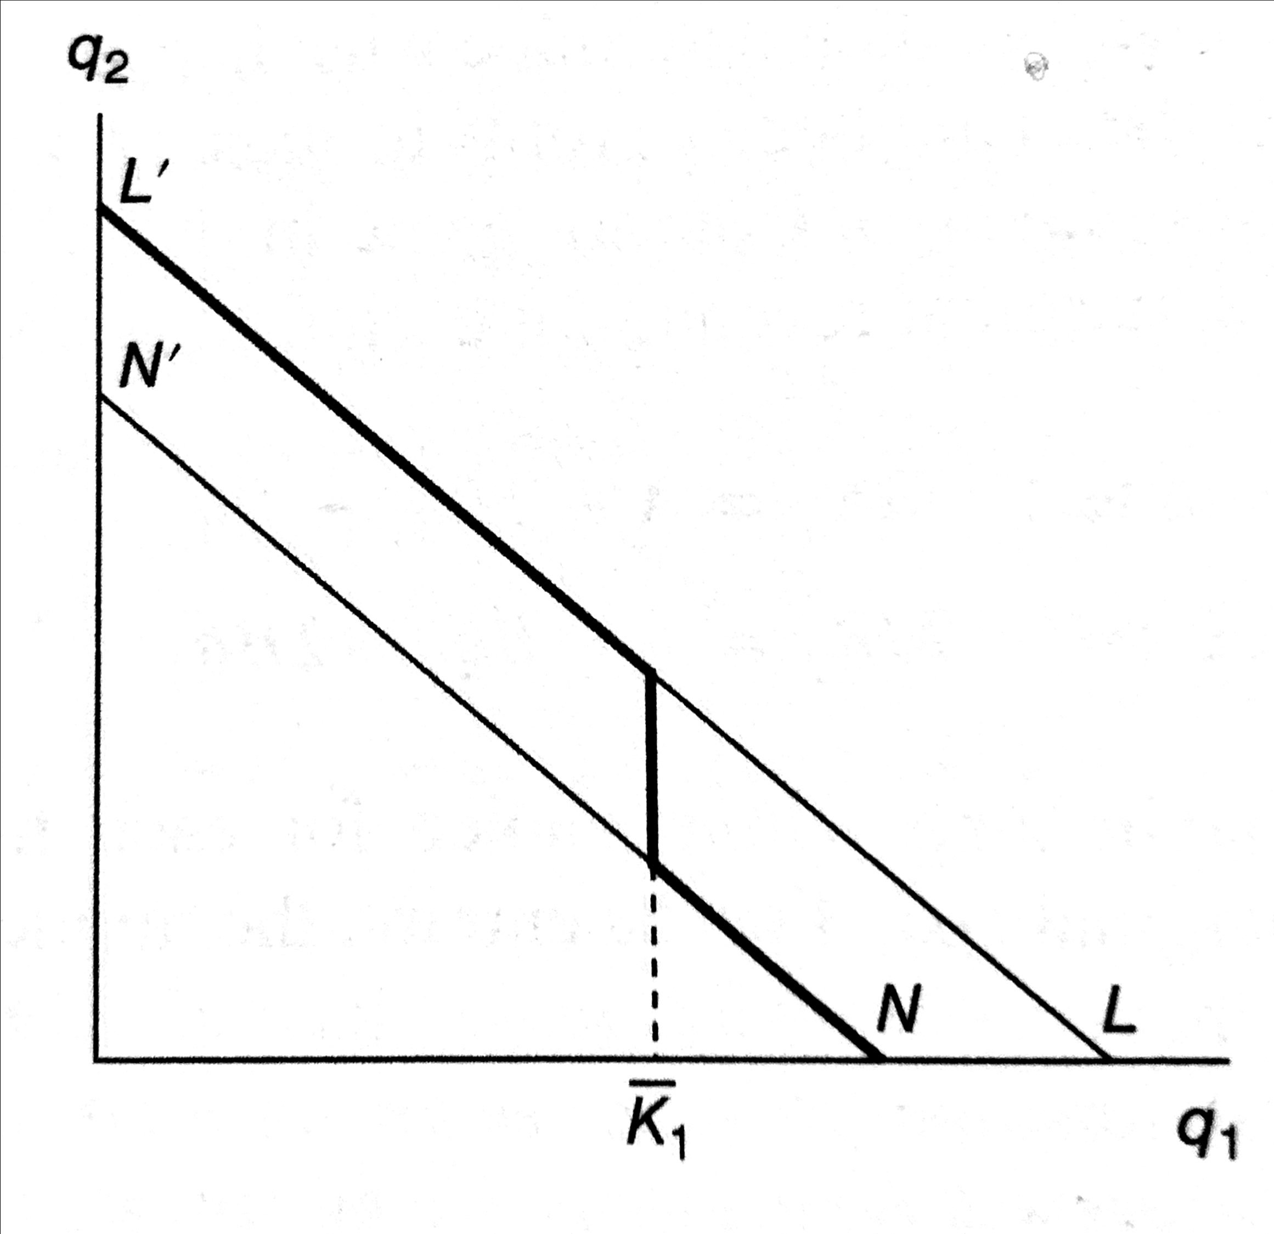
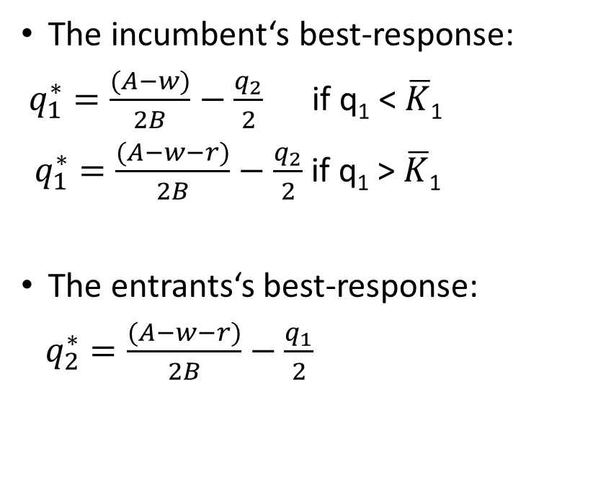
Capacity expansion as a commitment mechanism
Incumbent‘s best response
The incumbent‘s best-response:
$q_{1}^{∗}=\frac{(A−w)}{2B}−\frac{q_{2}}{2}$ if q₁ < $\overline{K}$₁
$q_{1}^{∗}=\frac{(A−w−r)}{2B}−\frac{q_{2}}{2}$if q₁ >$\overline{K}$₁
The entrants‘s best-response:
$q_{2}^{∗}=\frac{(A−w−r)}{2B}−\frac{q_{1}}{2}$

Slide 25
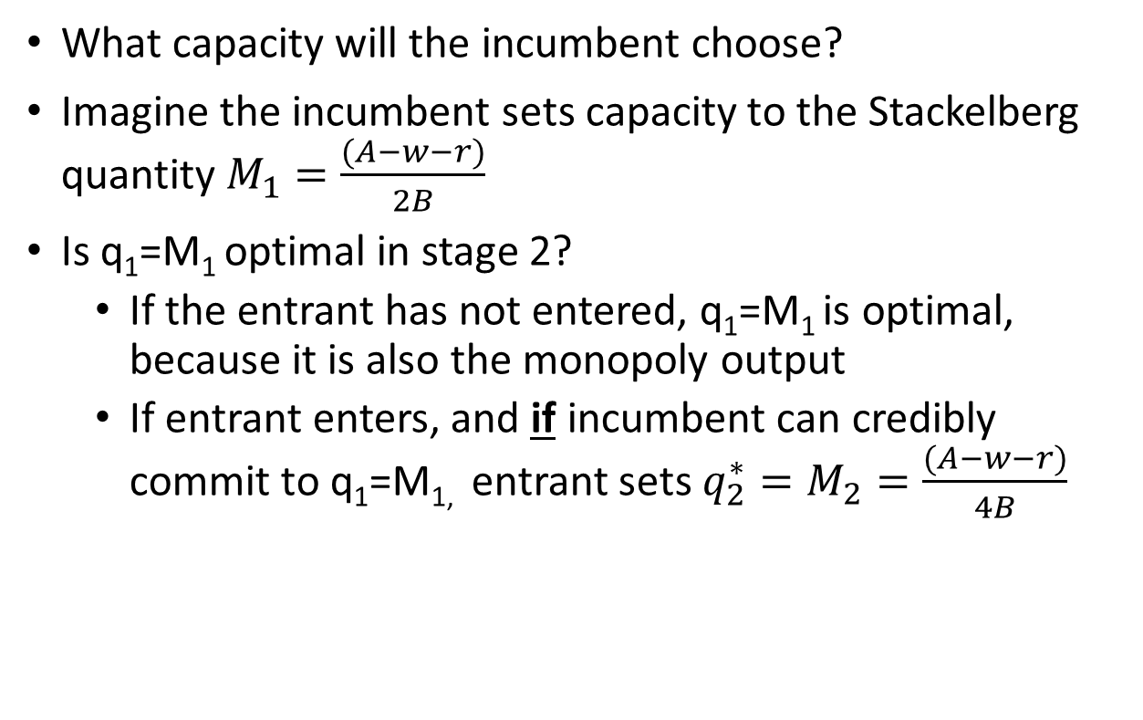
Capacity expansion as a commitment mechanism
What capacity will the incumbent choose?
Imagine the incumbent sets capacity to the Stackelberg quantity $M_{1}=\frac{(A−w−r)}{2B}$
Is q₁=M₁ optimal in stage 2?
If the entrant has not entered, q₁=M₁ is optimal, because it is also the monopoly output
If entrant enters, and if incumbent can credibly commit to q₁=M_{1,} entrant sets $q_{2}^{∗}=M_{2}=\frac{(A−w−r)}{4B}$

Slide 26
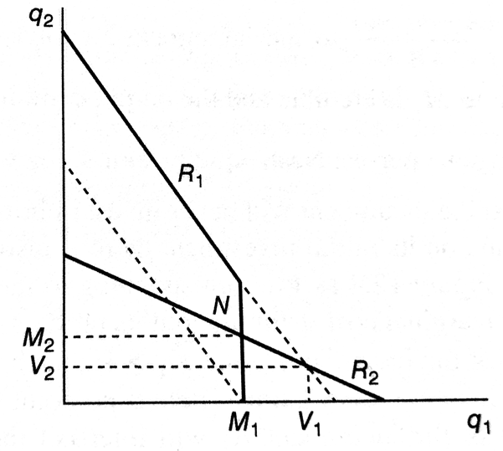
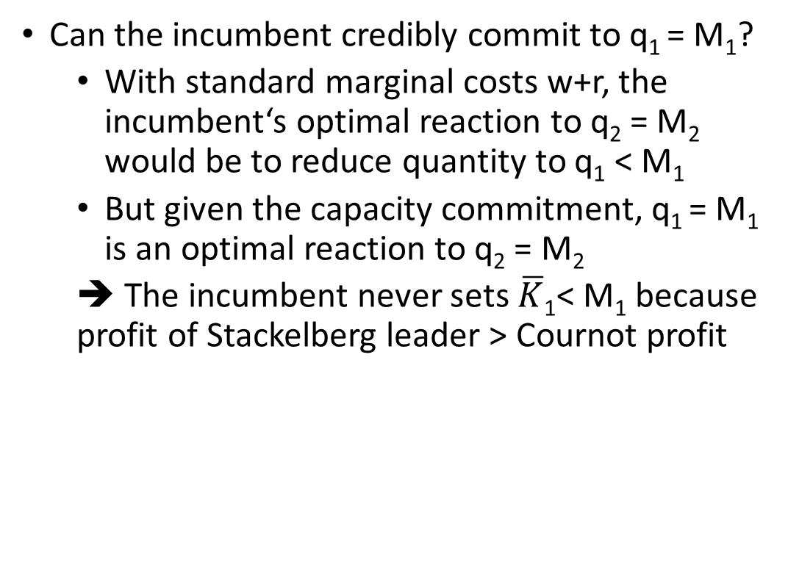
Capacity expansion as a commitment mechanism
Can the incumbent credibly commit to q₁ = M₁?
With standard marginal costs w+r, the incumbent‘s optimal reaction to q₂ = M₂ would be to reduce quantity to q₁ < M₁
But given the capacity commitment, q₁ = M₁ is an optimal reaction to q₂ = M₂
➔ The incumbent never sets $\overline{K}$₁< M₁ because profit of Stackelberg leader > Cournot profit

Slide 27
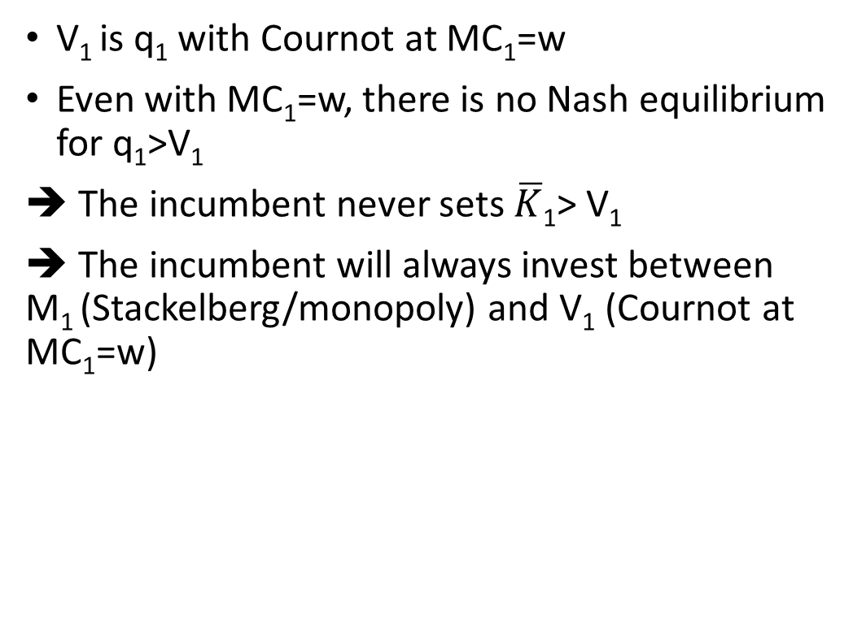
Capacity expansion as a commitment mechanism
V₁ is q₁ with Cournot at MC₁=w
Even with MC₁=w, there is no Nash equilibrium for q₁>V₁
➔ The incumbent never sets $\overline{K}$₁> V₁
➔ The incumbent will always invest between M₁ (Stackelberg/monopoly) and V₁ (Cournot at MC₁=w)

Slide 28
Capacity expansion as a commitment mechanism
3 cases
1. Entry not profitable even given q₁=M₁
➔Incumbent is monopolist, q₁=M₁, behaviour not predatory
2. Entry profitable even given q₁=V₁
➔ entry can only be accommodated by q₁=M₁
3. Break-even point between M₁ and V₁
➔ Incumbent sets capacity >M₁ to deter entry ➔ predatory conduct

Slide 29
Capacity expansion as a commitment mechanism
Summary
Note that there is no overall cost advantage of being incumbent or investing in capacity
The investment simply commits the incumbent to certain output
This is enough to deter or accommodate entry
Note that irreversibility of investment is crucial
If machinery can be sold for r, the commitment no longer works

Slide 30

Capacity expansion as a commitment mechanism
Application – Hotels (Conlin and Kadiyali, 2006)
The idea: No point of deterring entry if markets competitive
➔ Capacity overinvestment should happen in more concentrated markets
Test whether concentration is correlated with market excess capacity
Calculate HHI in markets defined by county or city and a type of hotel
Calculate hotel excess capacity in a market as 1 – average occupancy rate
Hotels in Texas over period 1991-1997

Slide 31
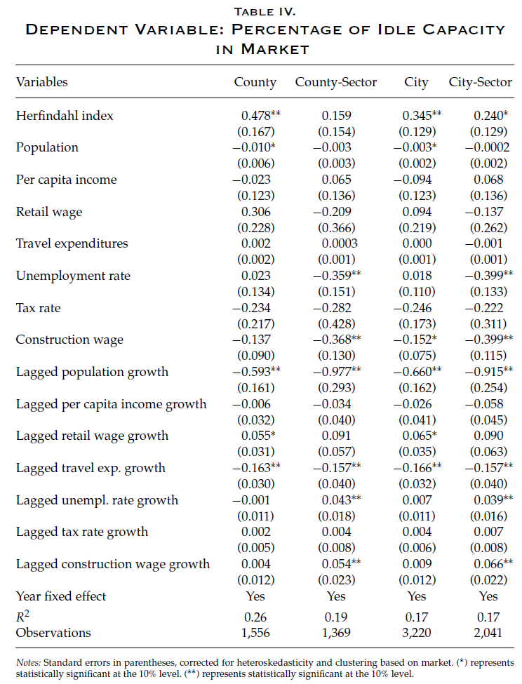
Market-level regressions

Slide 32
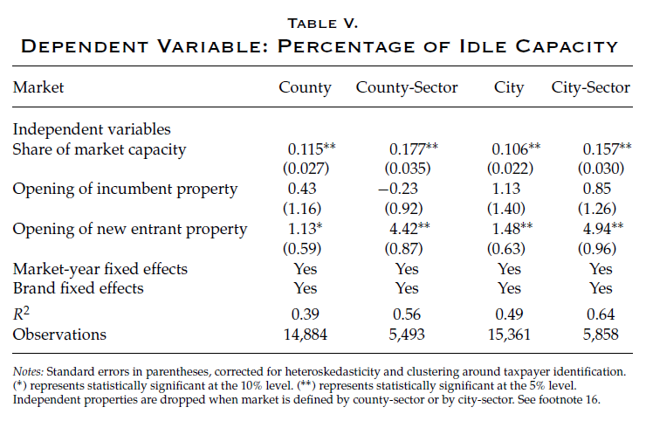
Firm-level regressions

Slide 33
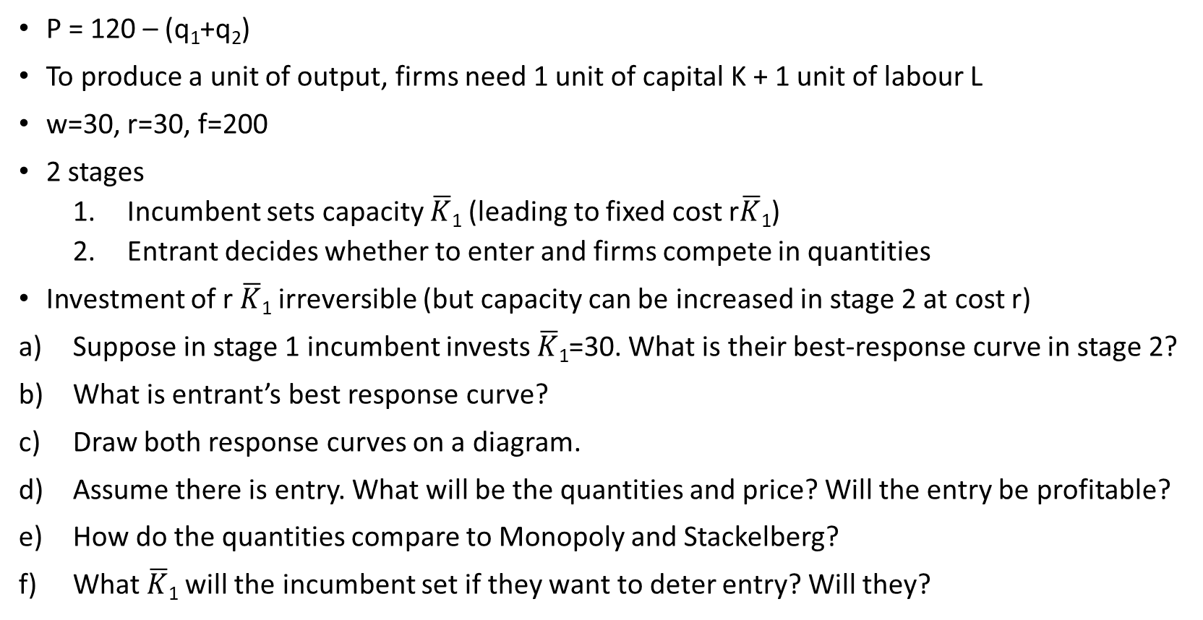
Practise question: Capacity choice
P = 120 – (q₁+q₂)
To produce a unit of output, firms need 1 unit of capital K + 1 unit of labour L
w=30, r=30, f=200
2 stages
Incumbent sets capacity $\overline{K}$₁ (leading to fixed cost r$\overline{K}$₁)
Entrant decides whether to enter and firms compete in quantities
Investment of r $\overline{K}$₁ irreversible (but capacity can be increased in stage 2 at cost r)
Suppose in stage 1 incumbent invests $\overline{K}$₁=30. What is their best-response curve in stage 2?
What is entrant’s best response curve?
Draw both response curves on a diagram.
Assume there is entry. What will be the quantities and price? Will the entry be profitable?
How do the quantities compare to Monopoly and Stackelberg?
What $\overline{K}$₁ will the incumbent set if they want to deter entry? Will they?

Slide 34
Topic outline
Basic model of entry deterrence
Taxonomy of strategies
Capacity investment as a committment device
What is “brand proliferation”?
Is there such a thing as predatory pricing?
Can firms leverage market power across markets?
What makes exclusionary contracts profitable?

Slide 35
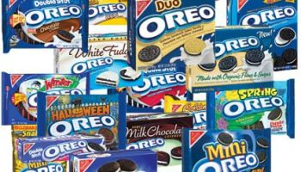
Brand proliferation
Firms often offer multiple products
Many possible reasons
Economies of scale and scope
Demand complementarities
But also entry deterrence
Assume
An incumbent can offer only a base product, or a base product and a modified product
It is optimal for a monopolist to produce 1 rather than 2 products: π^{m}(1) > π^{m}(2)
3 stages
Monopolist decides whether to introduce also the modified product
Potential entrant decides whether to pay sunk costs e and compete with the modified product
If entry, firms compete, getting duopoly profits π^{d}₁(k) and π^{d}₂(k)

Slide 36
Brand proliferation
Entrant’s profits are
π^{d}₂(1) – e if it competes with a single-product incumbent
0 – e if it competes with a two-product incumbent
0 if no entry
Assume that the incumbent is willing to carry the cost of introducing an extra brand if it allows them to be a monopolist, i.e. π^{m}(2) > π^{d}₁(1)
brand proliferation
This is sub-optimal except for deterring entry ➔ predatory conduct (as long as π^{d}₁(2) < π^{d}₁(1))
Any issue with this analysis?
What about commitment?
The strategy only works with high exit costs
Else incumbent wants to withdraw the modified product upon entry and strategy not credible

Slide 37
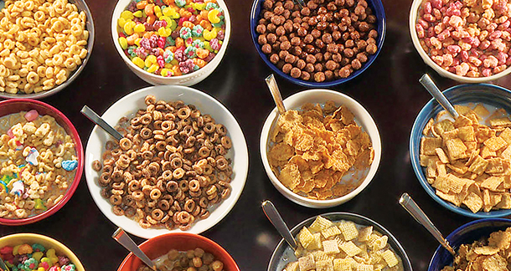
Brand proliferation
Example: ready-to-eat cereals (RTE) in US
Again economists‘ favourite market!
Between 1940s-1970s, 4 producers dominant and no major entry
Kellogg
General Foods
General Mills
Quaker Oats
Highly concentrated despite limited economies of scale or other natural barriers to entry (patents, control of raw material resources...)
But new brands regularly introduced
In 1972, accused by FTC of brand proliferation to prevent entry
Case eventually dismissed in 1982

Slide 38
Topic outline
Basic model of entry deterrence
Taxonomy of strategies
Capacity investment as a committment device
What is “brand proliferation”?
Is there such a thing as predatory pricing?
Can firms leverage market power across markets?
What makes exclusionary contracts profitable?

Slide 39

Predatory pricing
Can firms induce exit / deter entry by temporarily charging prices below costs?
Accusations frequently made but a few problems
In order to recover the losses, the predation has to be followed by a period of high profits ➔ threat of persistently low prices not credible. In fact, low price in stage 1 does on its own nothing to discourage entry in stage 2
Noteworthy that many competition cases not about deterring entry but making rivals exit
Chicago school criticism: accusation of predation made by inefficient rivals unable to compete

Slide 40
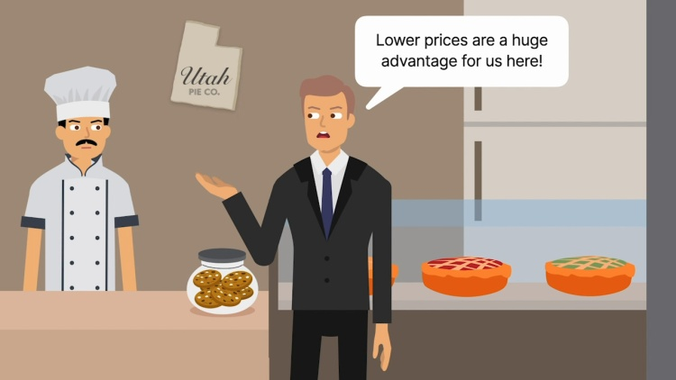
The Utah Pie case
A landmark antitrust lawsuit in 1960s
In 1960s, Utah Pie, a regional pie manufacturer, sued several larger baking companies for unfair trade practices
Utah Pie alleged that the larger baking companies were selling their products at unfairly low prices in the Salt Lake City market, making it difficult for Utah Pie to compete
In 1967, the Supreme Court ruled in favor of Utah Pie, establishing important legal precedents regarding predatory pricing and antitrust enforcement
However, SC dissent opinion: majority ruling protecting competitors rather than competition

Slide 41


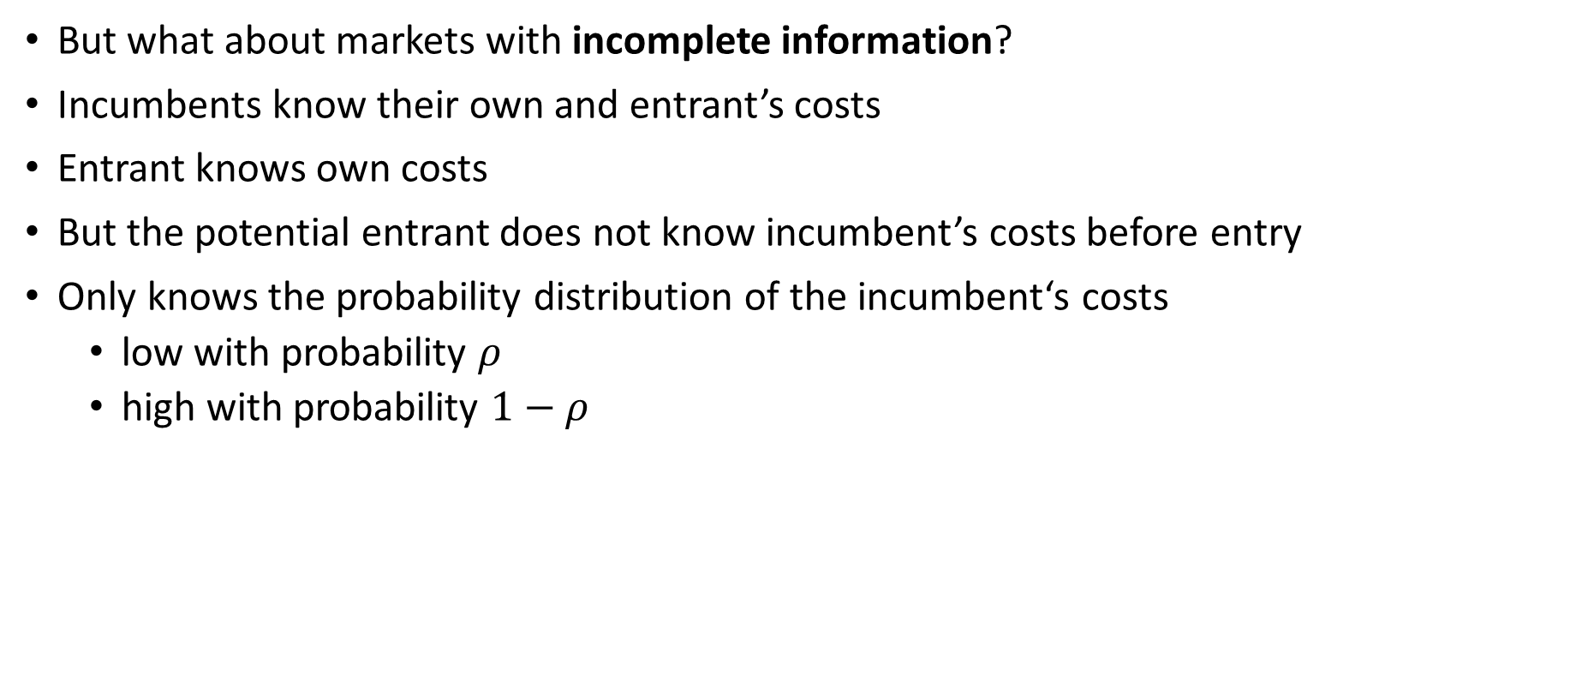
Limit pricing under incomplete information
But what about markets with incomplete information?
Incumbents know their own and entrant’s costs
Entrant knows own costs
But the potential entrant does not know incumbent’s costs before entry
Only knows the probability distribution of the incumbent‘s costs
low with probability $ρ$
high with probability $1−ρ$

Slide 42
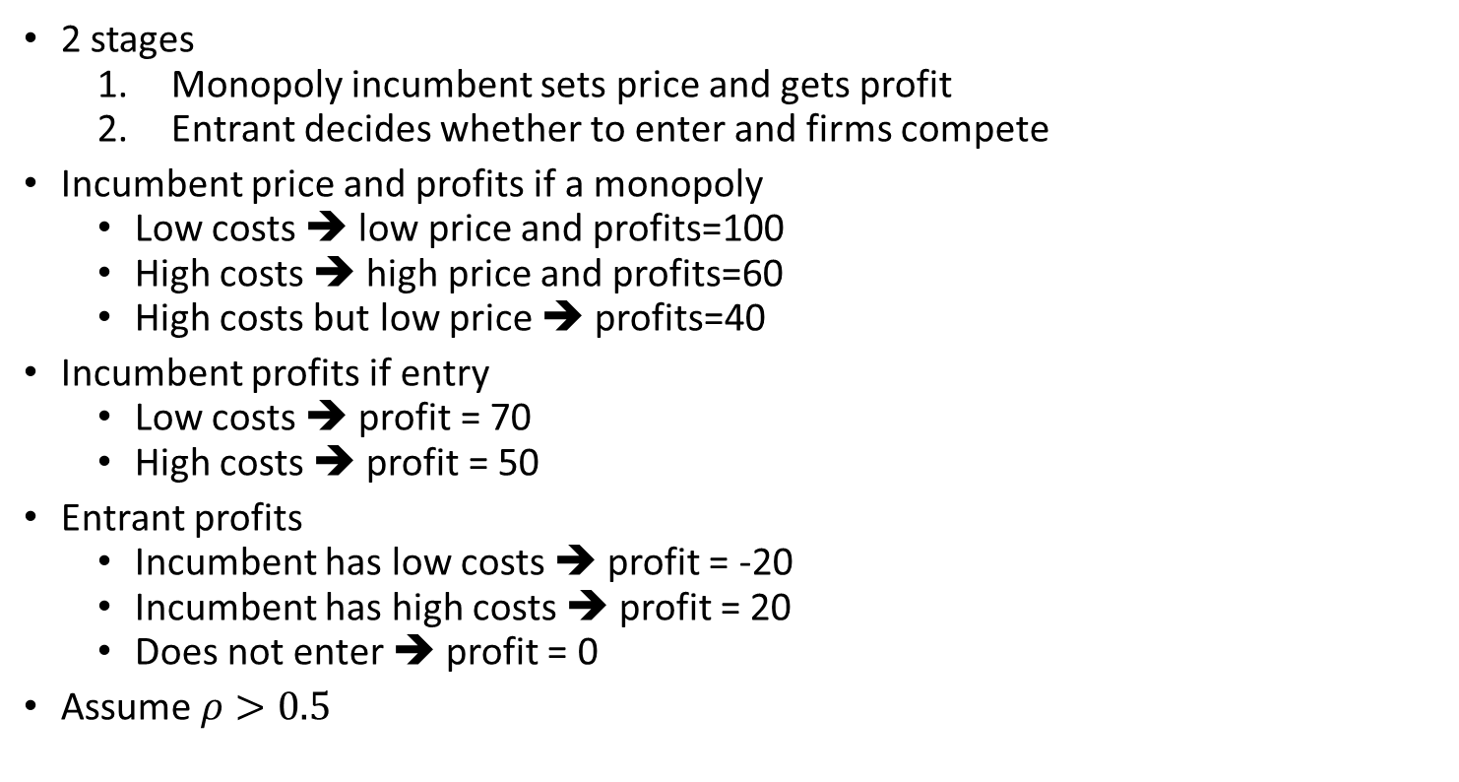
Limit pricing under incomplete information
2 stages
Monopoly incumbent sets price and gets profit
Entrant decides whether to enter and firms compete
Incumbent price and profits if a monopoly
Low costs ➔ low price and profits=100
High costs ➔ high price and profits=60
High costs but low price ➔ profits=40
Incumbent profits if entry
Low costs ➔ profit = 70
High costs ➔ profit = 50
Entrant profits
Incumbent has low costs ➔ profit = -20
Incumbent has high costs ➔ profit = 20
Does not enter ➔ profit = 0
Assume $ρ>0.5$

Slide 43
Limit pricing under incomplete information
Naive scenario
If high price in stage 1, entrant knows that incumbent has high costs ➔ entry
If low price in stage 1, entrant knows that incumbent has low costs ➔ no entry
But the incumbent knows this and can pretend to have low costs!

Slide 44
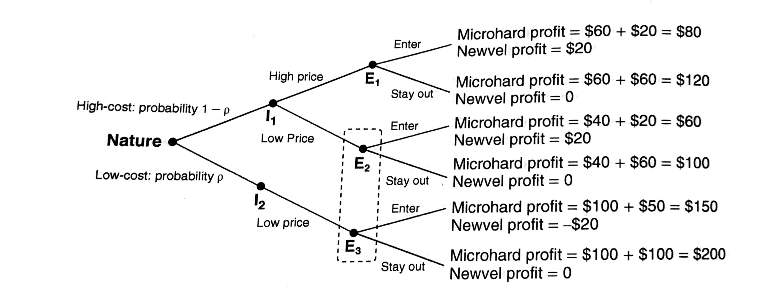
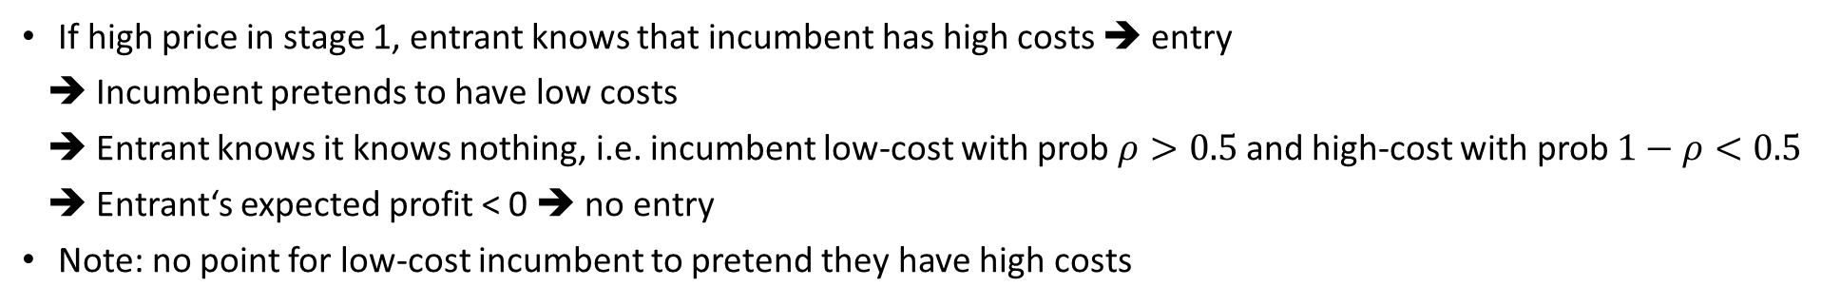
Limit pricing under incomplete information
Entrant does not know if we are in E₂ or E₃
If high price in stage 1, entrant knows that incumbent has high costs ➔ entry
➔ Incumbent pretends to have low costs
➔ Entrant knows it knows nothing, i.e. incumbent low-cost with prob $ρ>0.5$ and high-cost with prob $1−ρ<0.5$
➔ Entrant‘s expected profit < 0 ➔ no entry
Note: no point for low-cost incumbent to pretend they have high costs

Slide 45
Limit pricing under incomplete information
Definition: Bayesian Nash equilibrium:
Players have no incentive to unilaterally change their strategy
Beliefs are confirmed

Slide 46
Definition: Bayesian Nash equilibrium
Modelling games with asymmetric information potentially extremely complicated (and as a result not a realistic model of how people make decisions)
Greatly simplified by the concept of the Bayesian Nash equilibrium (John C. Harsanyi, Nobel Prize 1994)
Each player is assigned a type by nature (with a probabilistic distribution)
NE: Each player‘s strategy is the best response to all other players‘ strategies.
BNE: Each player‘s strategy is the best response to all other players‘ strategies given their beliefs about the state of the nature.
To see if we have a BNE
Players have no incentive to unilaterally change their strategy
Beliefs are confirmed

Slide 47
Limit pricing under incomplete information
Summary
BNE here:
Incumbent sets low price in stage 1 and high price in stage 2
Entrant does not enter
The incumbent sets lower price than otherwise to deter entry ➔ predatory

Slide 48
Topic outline
Basic model of entry deterrence
Taxonomy of strategies
Capacity investment as a committment device
What is “brand proliferation”?
Is there such a thing as predatory pricing?
Can firms leverage market power across markets?
What makes exclusionary contracts profitable?

Slide 49

Leveraging market power in market for complementary product
In 1990s, Windows market share > 90%
Netscape large share among internet browsers
Microsoft sued for intergrating Internet Explorer within Windows
Why complain that Microsoft throws in an extra product for free?

Slide 50
Leveraging market power in market for complementary product
Assume that operating systems and internet browsers are perfect complements
Q_{O} = 12 – (P_{O} + P_{B})
Q_{B} = 12 – (P_{O} + P_{B})
MC=0

Slide 51
Leveraging market power in market for complementary product
Two firms, each a monopolist in its market
Inverse demand conditional on the price of the other product
P_{O} = 12 – P_{B} – Q_{O}
P_{B} = 12 – P_{O} – Q_{B}
Firms FOC:
MR_{O} = 12 – P_{B} – 2Q_{O} = 0
MR_{B} = 12 – P_{O} – 2Q_{B} = 0
By substitution into demand curves
P_{O} = (12 – P_{B})/2
P_{B} = (12 – P_{O})/2
➔ Each monopolist, by increasing its price, imposes a negative externality on the other monopolist
In equilibrium
P_{O} = 4; P_{B} = 4
Q_{O} = Q_{S} = 4
Profit_{O} = 16; Profit_{B} = 16

Slide 52
Leveraging market power in market for complementary product
A single firm is a monopoly in both markets (e.g. if the 2 monopolists merge)
Just price of the set matters
Q_{S} = 12 – P_{S}
FOC
MR_{S} = 12 – 2Q_{S} = 0
In equilibrium
P_{S} = 6
Q_{S} = 6
Profit_{B} = 36 (>2*16) ➔ More than with two monopolists

Slide 53
Leveraging market power in market for complementary product
A monopolist in the OS but both firms compete in the browser market
Browser industry now competitive (Bertrand with homogeneous products)
P_{B} = MC = 0
The OS market inverse demand
P_{O} = 12 – Q_{O}
The OS monopolist’s FOC
MR_{O} = 12 – 2Q_{O} = 0
In equilibrium
P_{O} = 0; P_{O} = 6
Q_{B} = Q_{O} = 6
Profit_{O} = 36 ➔ Equivalent to a monopolist controlling both markets

Slide 54
Leveraging market power in market for complementary product
Did Microsoft abuse power to maintain or extend dominant position?
Microsoft used its dominant position in the OS market to dominate the browser market
But Microsoft had nothing to gain from foreclosing competition in the market for browsers
And possible to argue that the bundling was actually pro-competitive as price went down
Important insight by the Chicago School starting in 1970s: using tying/bundling to leverage market power between markets makes little sense
Or was it more complicated...?

Slide 55
Leveraging market power in market for complementary product
The previous conclusions not true with network externalities
OS: more users mean more applications, and more applications mean more users
browser can also carry applications and work as an OS of sorts
➔ by foreclosing the browser, Microsoft was actually foreclosing possible competition in its core market – OS
Circumstencial evidence suggesting this was indeed the case
internal documents expressing concern over Netscape competition
pressuring Macintosh to also use Internet Explorer as default
paying AOL (a competitor) to do the same
Initial court ordered to break up Microsoft
An appelate court confirmed most findings and opted for a more targeted resolution
Initial court ordered to break up Microsoft
An appelate court confirmed most findings and opted for a more targeted resolution
Conclusion: bundling/tying can be “harm-less” price discrimination technique, but it can also sometimes be used extend one‘s market power

Slide 56
Topic outline
Basic model of entry deterrence
Taxonomy of strategies
Capacity investment as a committment device
What is “brand proliferation”?
Is there such a thing as predatory pricing?
Can firms leverage market power across markets?
What makes exclusionary contracts profitable?

Slide 57
Exclusionary contracts
Setup
Consumer with V=100
Incumbent with MC₁=50
Potential entrant with ex-ante unknown MC₂ draw from uniform(0,1) distribution

Slide 58
Exclusionary contracts
In the absence of a contract
No entry (50% probability)
P=100
π₁ = 50
π ₂ = 0
Entry (50% probability)
P=50
π ₁ = 0
π ₂ = 50-MC₂
Expected pay-offs
Buyer: E(CS) = 100 – (0.5*50+0.5*100) = 25
Incumbent: E(π ₁) = 0.5*50+0.5*0 = 25
Entrant: E(π ₂) = 0.5*0 +0.5*25 = 12.5
Social welfare: W = 62.5

Slide 59
Exclusionary contracts
A contract where incumbent promises price P=75, with a breach-of-contract fine = 50
No entry (75% probability)
P=75
π₁ = 25
π ₂ = 0
Entry (25% probability)
P=25
π ₁ = 0
π ₂ = 25-MC₂
Expected pay-offs
Buyer: E(CS) = 100 – (0.75*75 + 0.25*(25+50)) = 25
Incumbent: E(π ₁) = 0.75*25 + 0.25*50 = 31.25
Entrant: E(π ₂) = 0.75*0 + 0.25*12.5 = 3.125
Social welfare: W = 59.25
welfare declines because contract blocks entry by potentially efficient firm

Slide 60
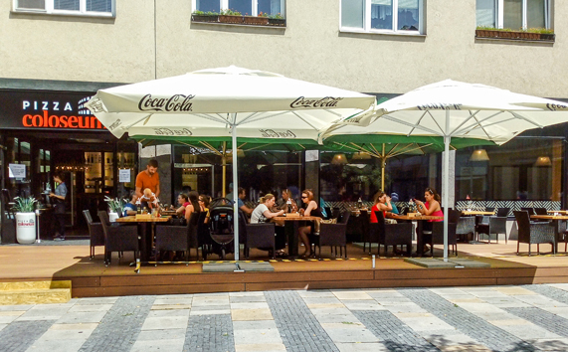
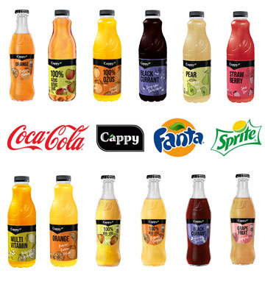
Exclusionary contracts: example

Slide 61
What is the difference between entry deterrence and accommodation?
How are predatory practices defined?
Why would a firm invest in capacity if there are no efficiency benefits?
Why are accusations of predatory pricing often not credible?
How do exclusionary contracts work?
What questions do you have?

